Slide 1
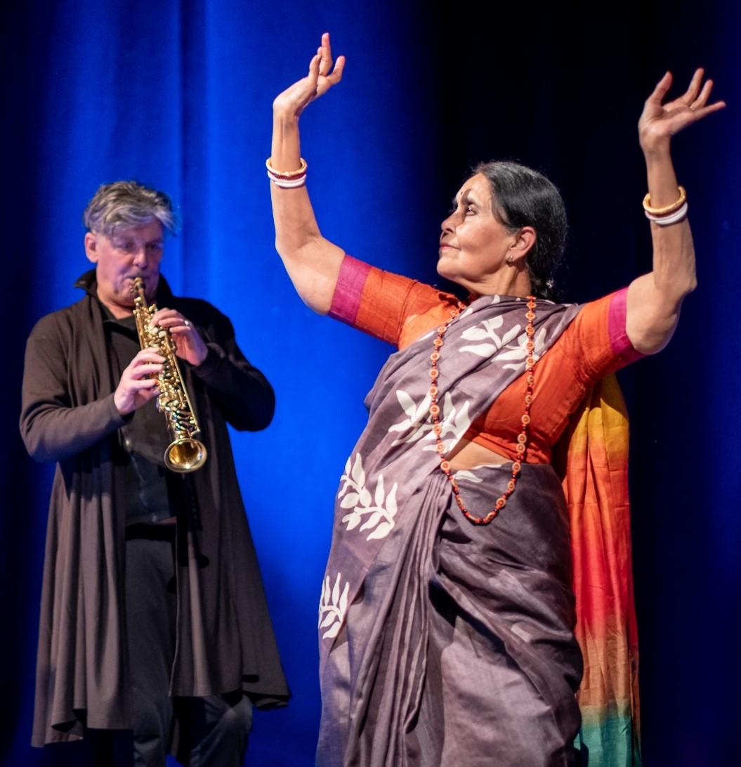
Celebrating Age
March 2021

Slide 2
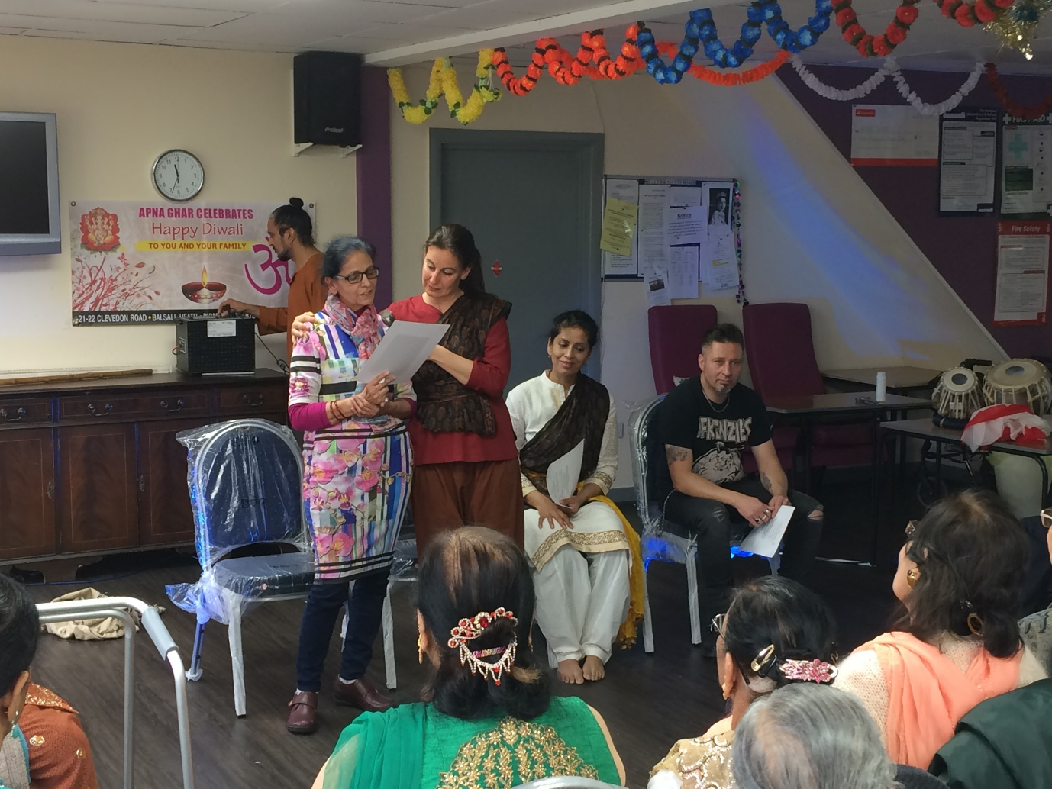

Slide 3
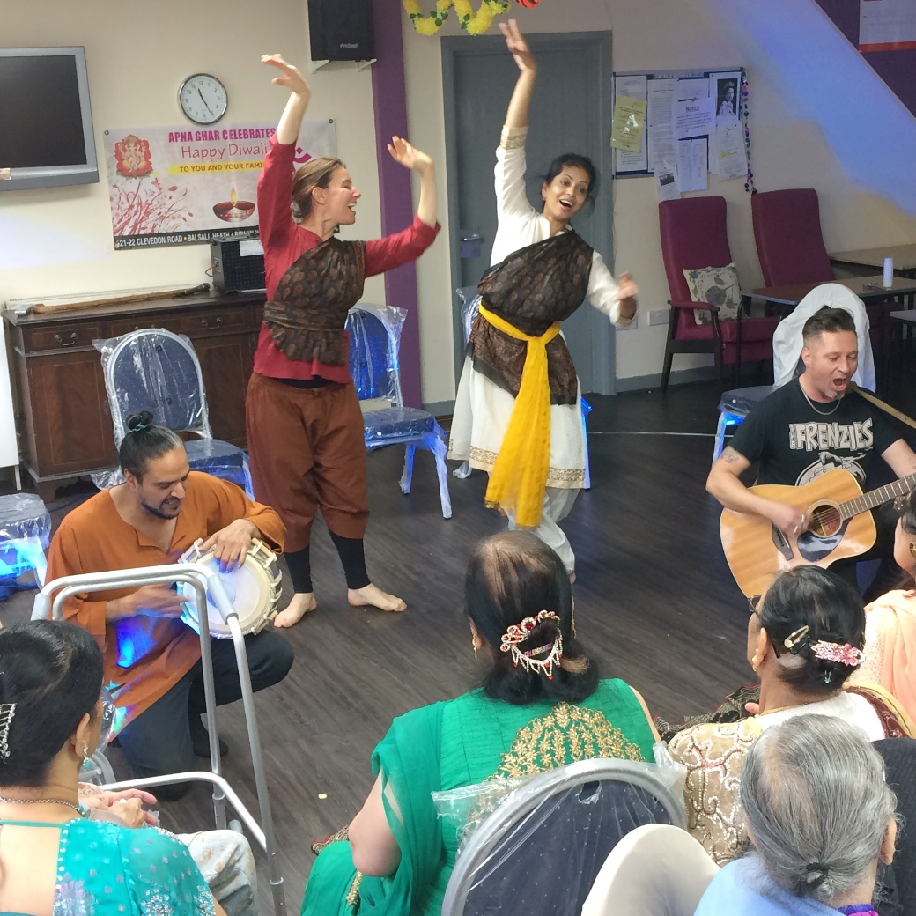
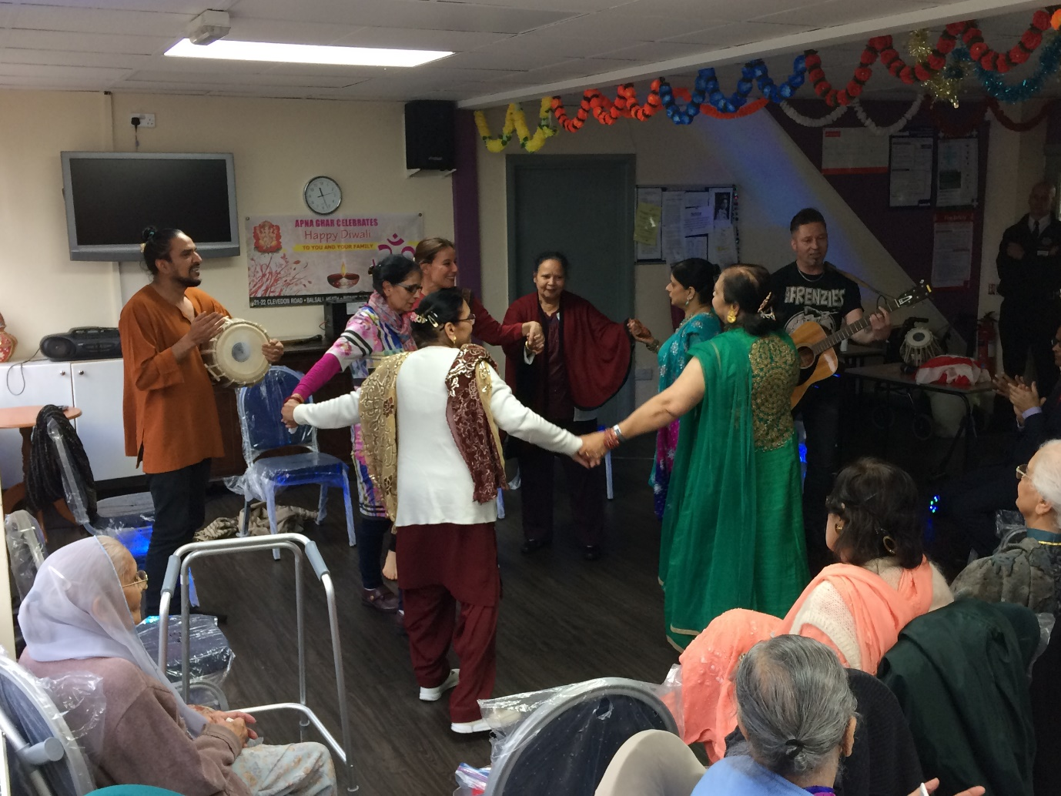

Slide 4
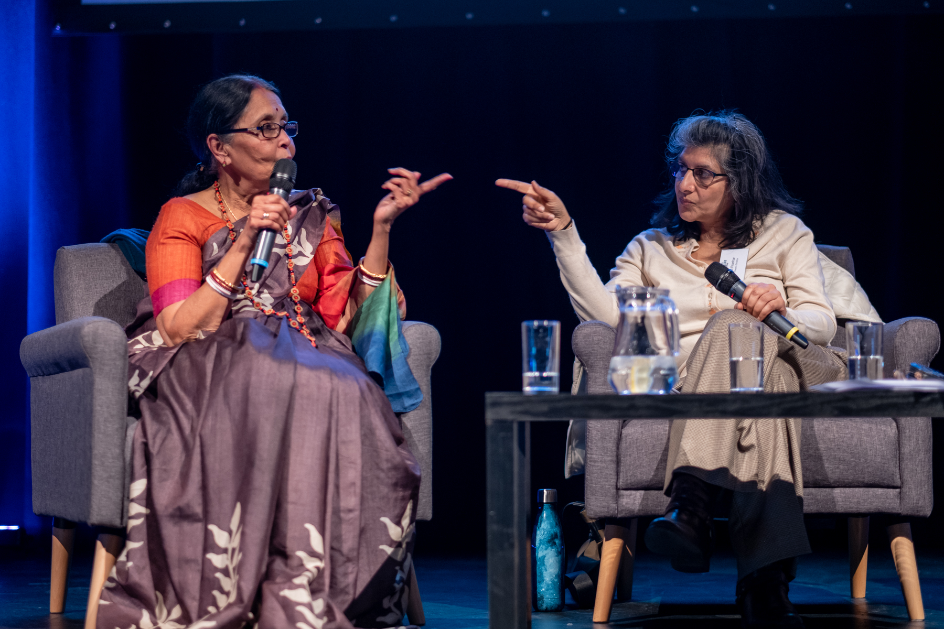
Critical Conversations: with Older artists
Bisakha Sarker & Arti Prashar

Slide 5
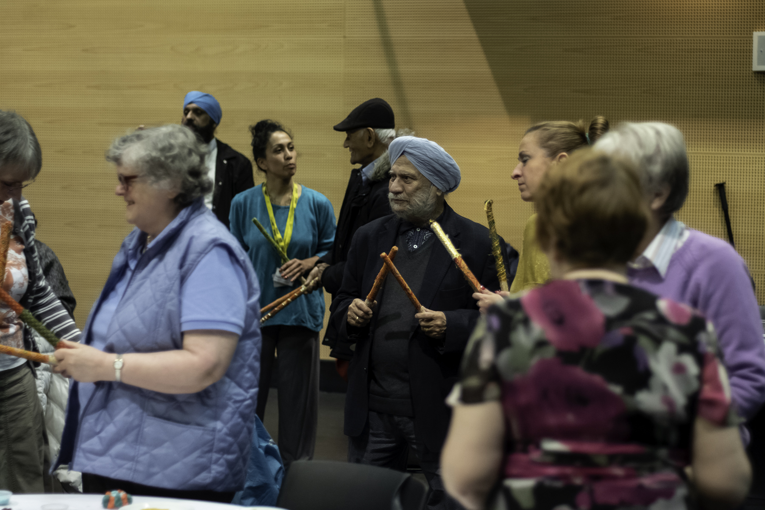
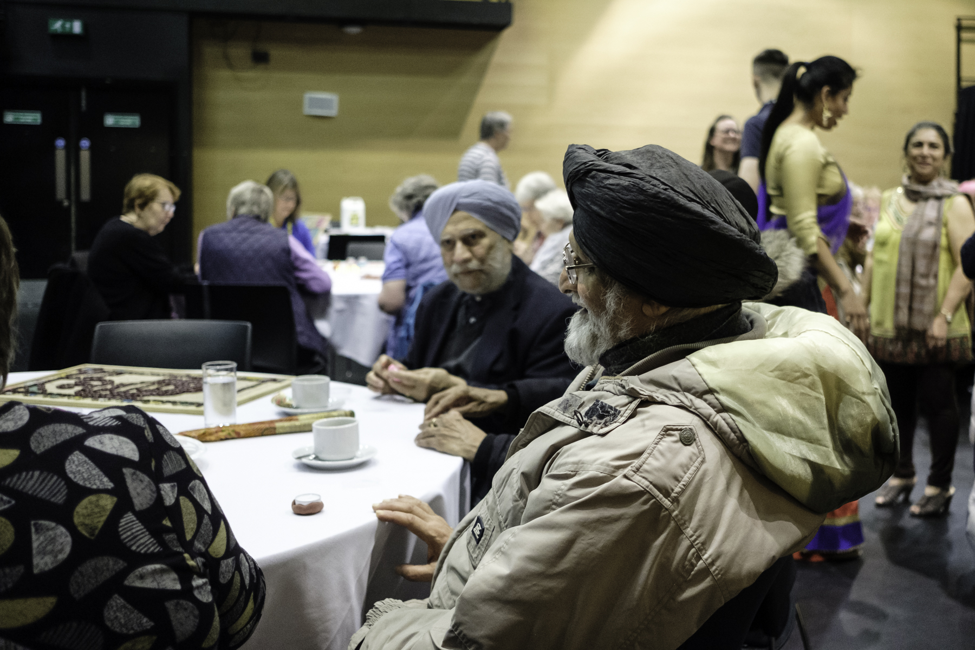
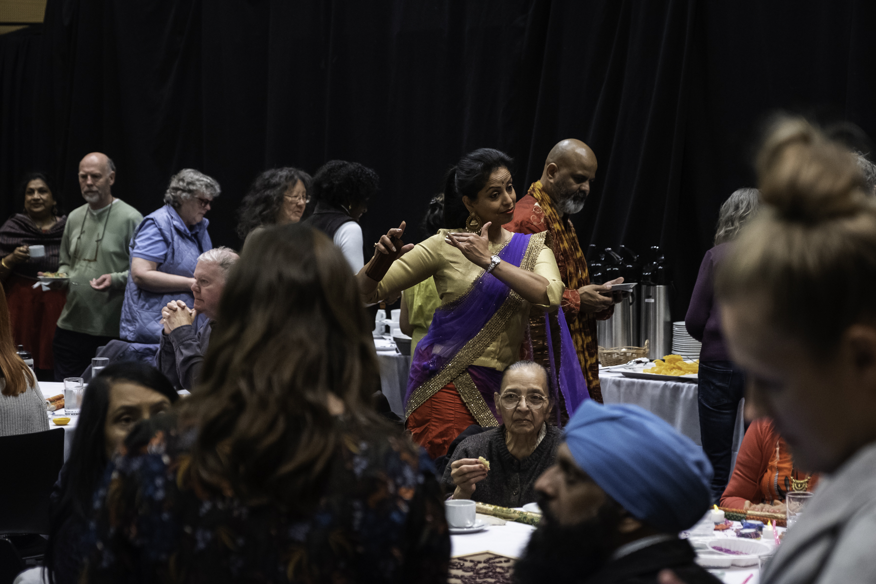
Culture Club
Free & popular, monthly sharing over creative activities – usually in partnership with agencies and invited arts organisations

Slide 6
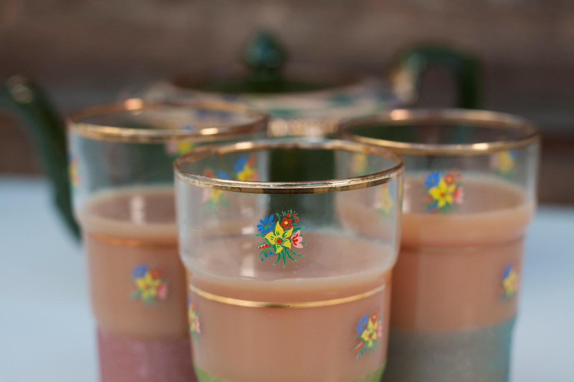
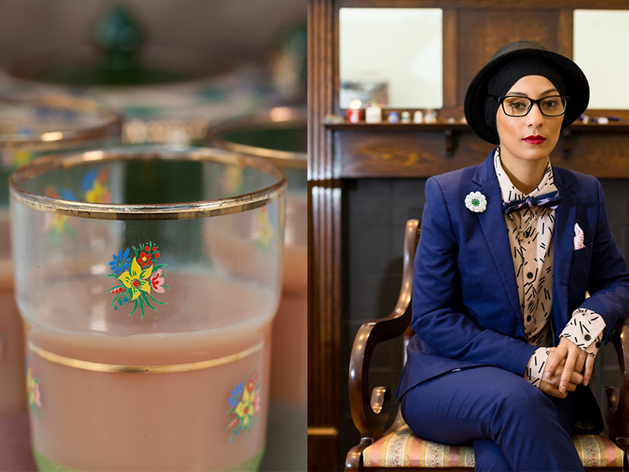
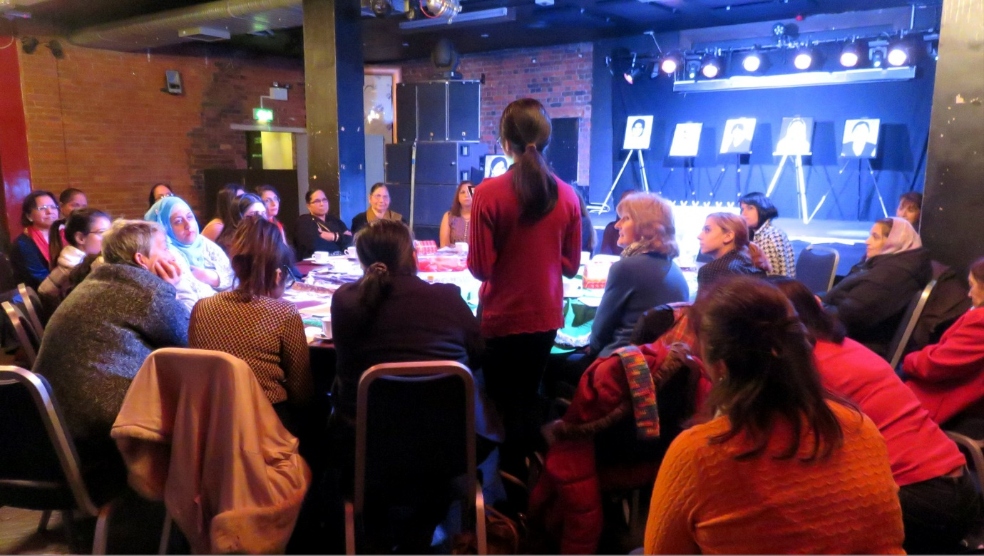
Chai and Chat
Inclusive space for women of all ages to talk, share and make art in community settings, homes and arts venues

